Slide 1
Electricity & Magnetisms 2
Dr Harrison Lee
Office: G6519
Consultation hour: Thu 10 am – 11 am

Slide 2
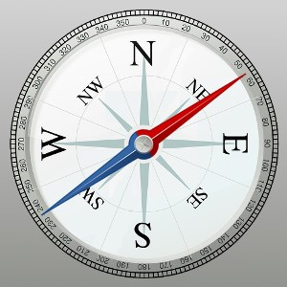
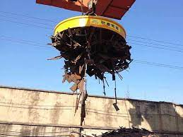
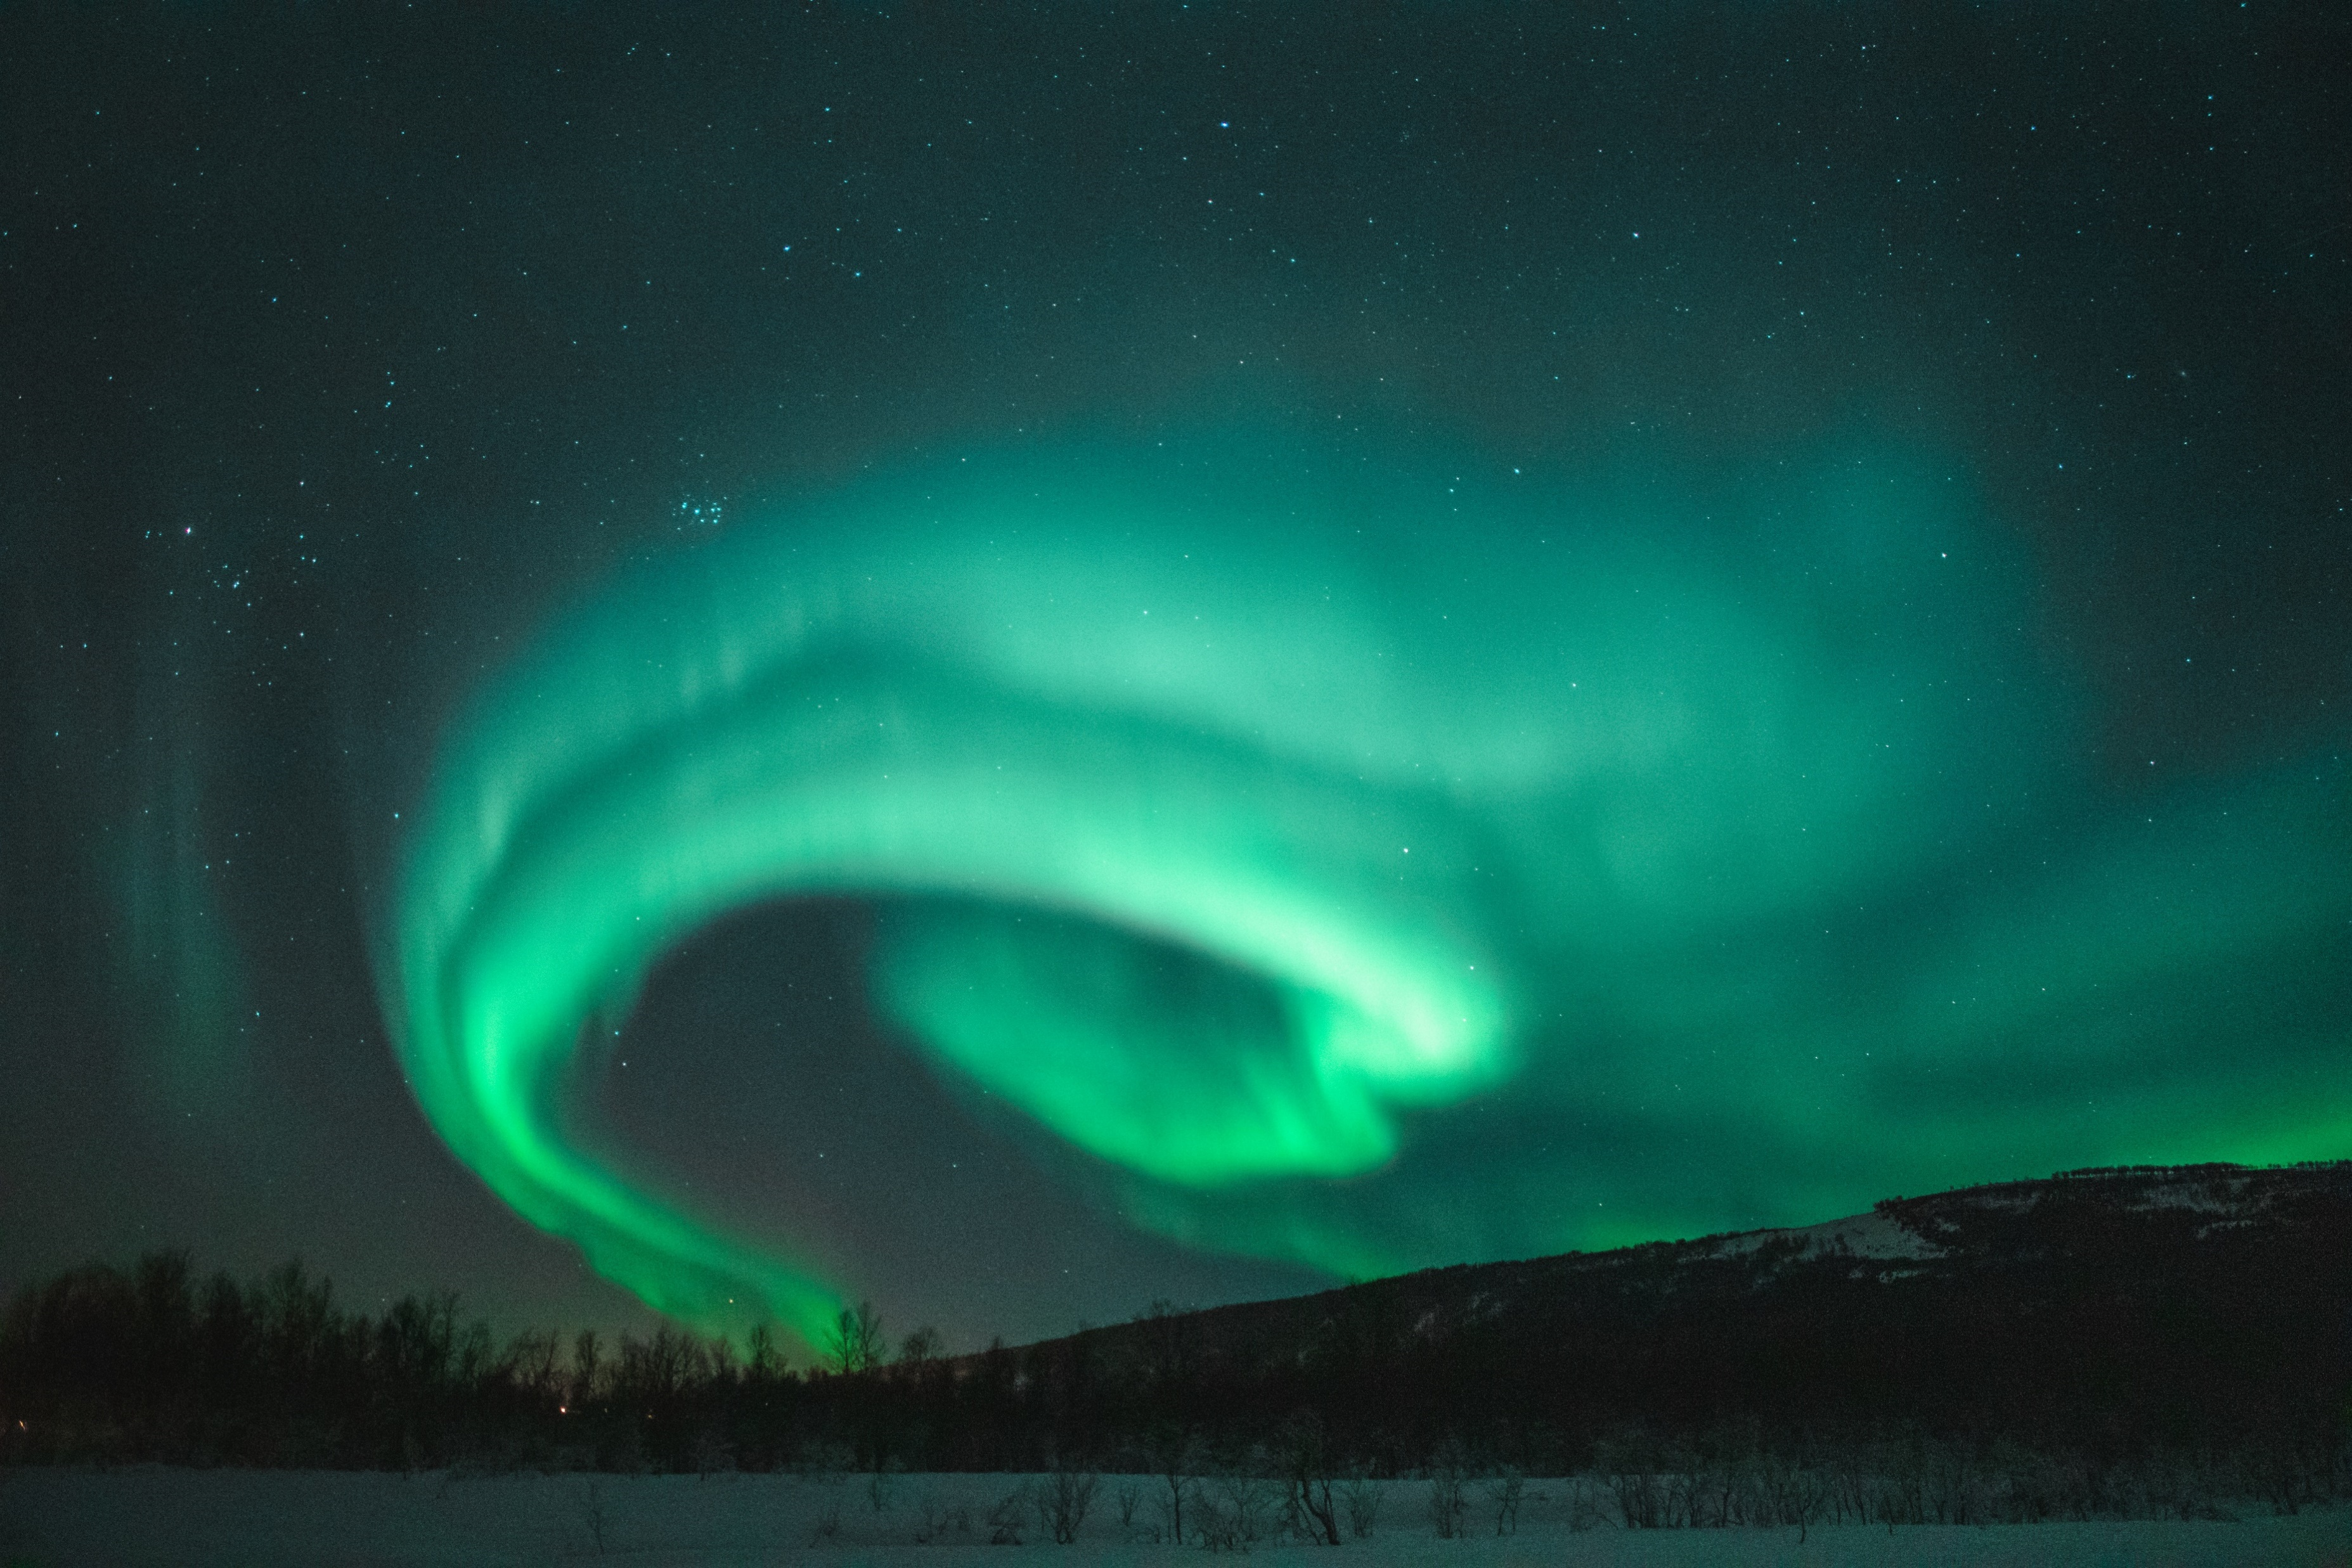
Introduction magnetism
How does a compass work?
What is electromagnets?
What are auroras?

Slide 3
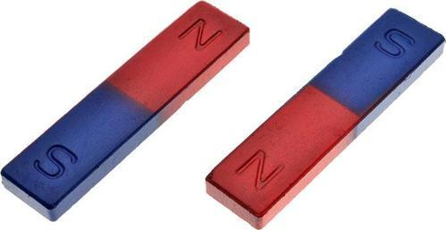
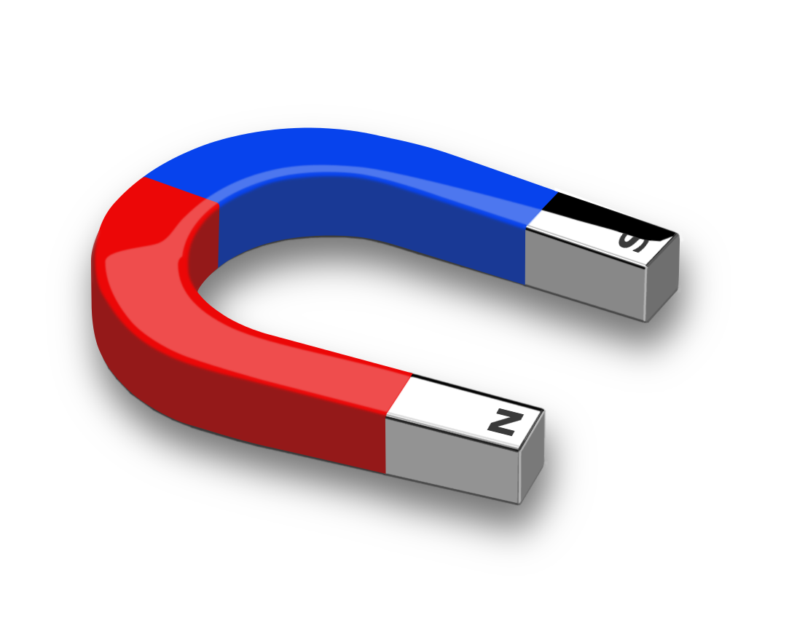
Magnets
A piece of metal which can attract iron or other magnetic materials or other magnets
The two ends of a magnet have different polarity (North and South poles, denoted by N and S respectively)
Opposite poles can attract
Like poles repel each other
A compass needle is a small magnet
The earth is a giant magnet

Slide 4
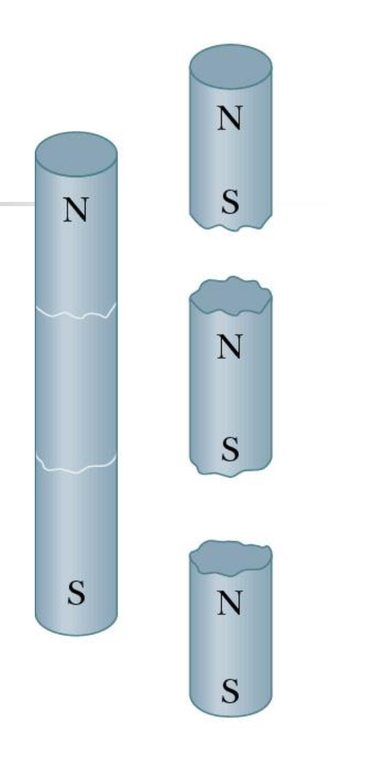
Breaking a magnet
If you break a magnet, each fragment becomes a separate magnet, with its own north and south poles.

Slide 5
The magnetic field B
Electric charge produces an electric field E in the space around it
A magnet produces a magnetic field B in the space around it, magnetic field exerts a force on a magnet in the field
The two poles of a magnet must exist at the same time and the magnetic field lines must start from north pole and end at south pole
The magnetic field rotates magnets, so the north pole follows the direction of the field line and south poles move opposite to the direction of field line

Slide 6
Magnetic dipole
A magnet has two poles (N and S), called magnetic dipole
The two poles of a magnet must exist at the same time
We can have a single positive or negative charge, but there is NO experimental evidence of magnetic monopole
In electric field, the field line can go to infinity

Slide 7
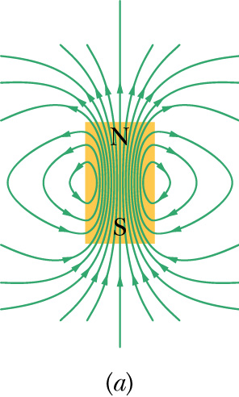
Magnetic field lines
We can represent magnetic fields with field lines, as for electric fields
The direction of B at any point is the direction of tangent to the magnetic field line
The density of the lines represents the magnitude of B — the magnetic field is stronger where the lines are denser, and conversely

Slide 8
Earth – a giant magnet

Slide 9
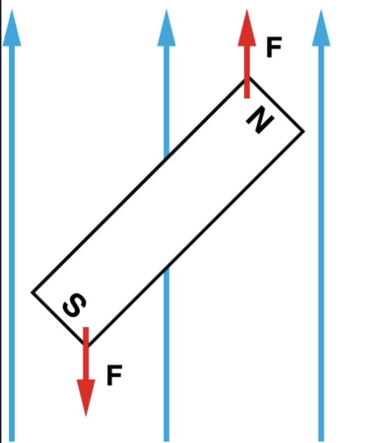
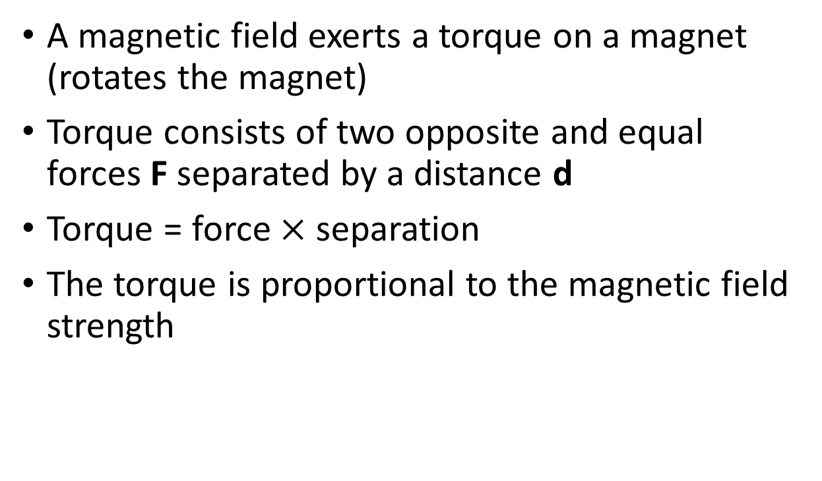
Effect of magnetic field
A magnetic field exerts a torque on a magnet (rotates the magnet)
Torque consists of two opposite and equal forces F separated by a distance d
Torque = force $×$ separation
The torque is proportional to the magnetic field strength

Slide 10
How does a compass work?
The compass needle is in fact a small magnet which aligns with the direction of the magnetic field originated from earth.

Slide 11
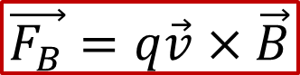
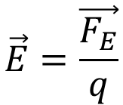
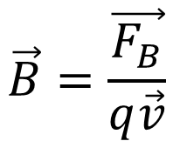
Definition of the magnetic field
$$\vec{E}=\frac{\vec{F_{E}}}{q}$$
Definition of electric field
Since we do not have magnetic monopole, we cannot define B in this way
Experimentally, we find that when a charged particle moves through a magnetic field with velocity v, a force F_{B} due to the field will act on the particle
Since F_{B}, v and q can be measured, this proves to be a convenient way to define B
$$\vec{B}=\frac{\vec{F_{B}}}{q\vec{v}}$$
$$\vec{F_{B}}=q\vec{v}×\vec{B}$$

Slide 12
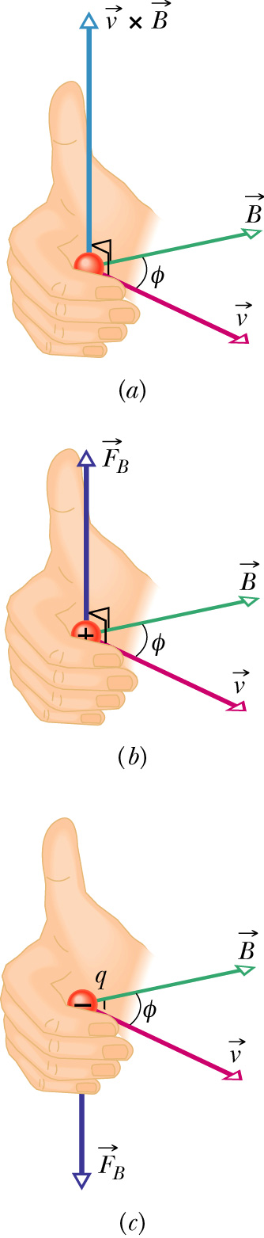

The direction of the magnetic force
$$\vec{F_{B}}=q\vec{v}×\vec{B}$$
The force F_{B} acting on a charged particle moving with velocity v through a magnetic field B is always perpendicular to v and B.
Direction is determined by the right-hand rule (in which v is swept into B through the smaller angle φ between them) gives the direction of v × B as the direction of the thumb.
If q is positive, then the direction of F_{B} = q v X B is in the direction of v × B. If q is negative, then the direction of F_{B} is opposite that of v × B.

Slide 13
A moving charge in magnetic field

Slide 14
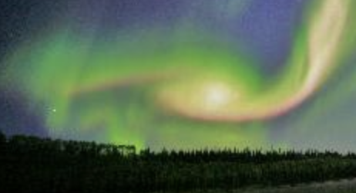
What are auroras?
Magnetic field can exert a force on a moving charge
Charge particles in solar wind from sun are influenced by earth’s magnetic field and concentrated in the two poles
They have high energy and cause gas molecules to emit light – the polar light, auroras

Slide 15
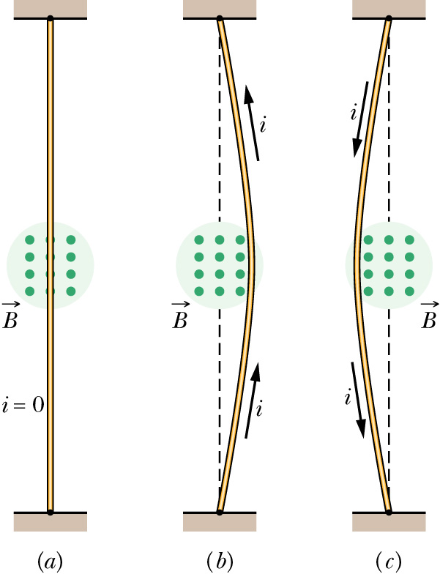
Current in magnetic field
A wire with current in a magnetic field (green dots)
Current consists of moving charges (defined as positive charges although electrons are in fact moving)
No current, the wire is straight
With upward current, the wire is deflected rightward
With downward current, the deflection is leftward
A magnetic field exerts a sideways force on electrons moving in a wire. This force is transmitted to the wire because the electrons cannot escape

Slide 16
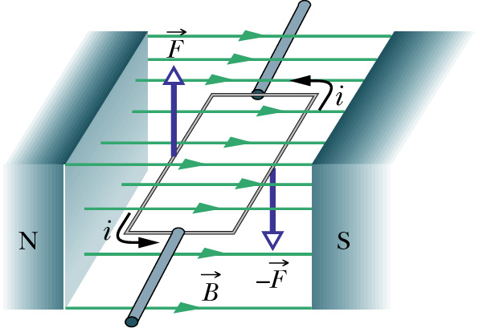
Torque on a current loop – electric motor
A rectangular loop of wire, carrying a current and free to rotate about a fixed axis, in a magnetic field
Magnetic forces on the wire of the loop produce a torque that rotates it
A commutator (not shown) reverses the direction of the current when rotate by 180º so that the torque always acts in the same direction.
The current loop is continuously rotated → electric motor

Slide 17
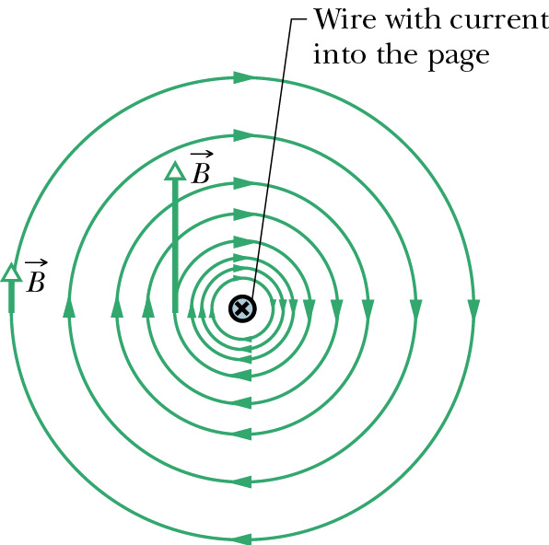
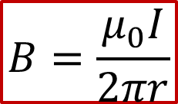
Generation of magnetic field
Moving charge can generate a magnetic field
A current consists of moving charges
A current can generate a magnetic field
Direction of field determines by right hand rule
Thumb along direction of current, other finger gives direction of field
$$B=\frac{μ_{0}I}{2πr}$$

Slide 18
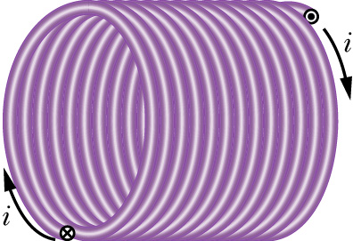
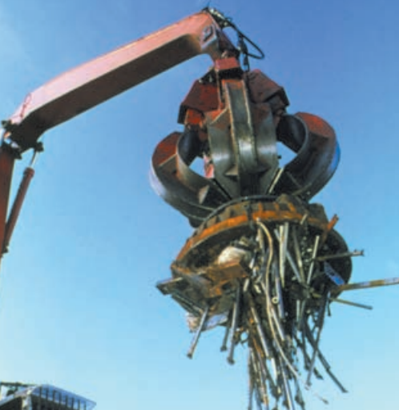
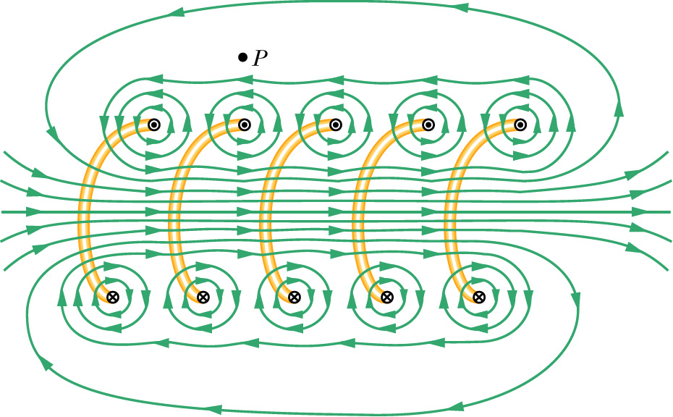
Solenoids
Solenoids – a long coil of wire with many turns
The B field inside is nearly uniform
It is an electromagnet, switch on-off by current
Considered the stretched out solenoids
Each turn produces circular magnetic field lines near it
Near the solenoid's axis, the field lines combine into a net magnetic field that is directed along the axis, parallel to the axis of the solendoid
More turns, stronger field

Slide 19
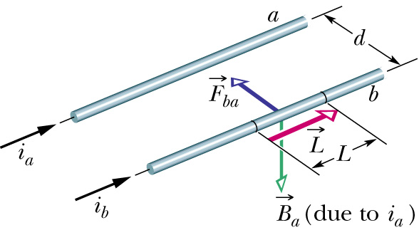
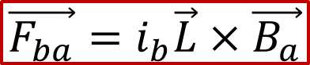
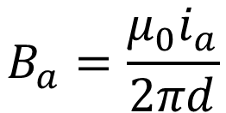
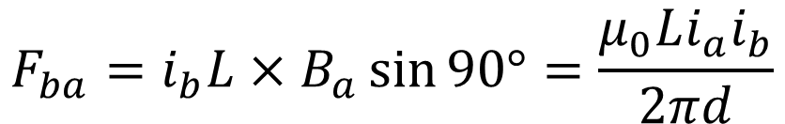
Force between parallel currents
$$B_{a}=\frac{μ_{0}i_{a}}{2πd}$$
B field due to i_{a},
i_{b} flowing in B_{a}
Wire b experiences a force
Parallel currents attract, and antiparallel currents repel
$$\vec{F_{ba}}=i_{b}\vec{L}×\vec{B_{a}}$$
$$F_{ba}=i_{b}L×B_{a}\sin{90°}=\frac{μ_{0}Li_{a}i_{b}}{2πd}$$

Slide 20
Why do materials show magnetic property?
Materials have electrons
Electrons have a spinning motion and orbital motion
Spin and orbital motion give rise to currents
Thus electron acts like a small magnet
If they are randomly oriented, there is no magnetic field
If they are orderly aligned, it produces magnetic field

Slide 21
Magnetic materials
Due to different atomic origins of magnetic materials, there are different magnetic behaviours that occur in materials
Diamagnetism
Paramagnetism
Ferromagnetism

Slide 22
Diamagnetism
In diamagnetism,
Material is repelled by a magnetic field
Repulsion occurs irrespective of whether the material is placed near a north pole or a south pole of a magnet
Often the weakest of the tree types of magnetism in materials
All materials exhibit diamagnetism but it is often overwhelmed in paramagnetic and ferromagnetic materials
The external magnetic field align the small magnet inside. But they are opposite to the external field. They repel the external field.

Slide 23
Magnetic levitation of diamagnetic materials
Diamagnetic materials are not strong enough for levitation of train
http://www.youtube.com/watch?v=jyqOTJOJSoU
https://www.youtube.com/watch?v=VC3r9-OaWes

Slide 24
Paramagnetism
In paramagnetism,
The material is attracted by a magnetic field
Attraction occurs irrespective of whether the material is placed near the north pole or south pole of a magnet
Usually stronger than diamagnetism but weaker that ferromagnetism.
The small magnets are along the direction of the field

Slide 25
Paramagnetism
https://www.youtube.com/watch?v=jiXQKAwoRLY&feature=related

Slide 26
Ferromagnetism
Ferromagnetism
A much stronger effect than paramagnetism or diamagnetism
Found in materials such as iron, nickel, or cobalt
The phenomenon gives us magnets
Applications in recording and data storage (harddisk, magnetic tape)

Slide 27
Ferromagneticism – magnetic domain
The atoms of a ferromagnetic material has magnetic moment (is a small magnet)
In a small region called a magnetic domain in a ferromagnetic material, all the atoms’ magnetic moments are aligned in the same direction due to interaction between atoms
A crystal of ferromagnetic material normally consist of many microscopic domains that are randomly oriented with respect to each other

Slide 28
Ferromagneticism – magnetic domain
When a magnetic field is applied, some of the domains will align with the external field
As the field is increased, more domains will be realigned and result in strong magnetic field. The alignment is good and thus the magnetic field produced is strong.
Even when the external field is removed, some of the domains will remain at the alignment they held, creating a permanent magnetic moment, i.e. a permanent magnet.

Slide 29
Magnetic domain and creation of a magnet
The magnetic domains are aligned by an external field and a magnet is created

Slide 30
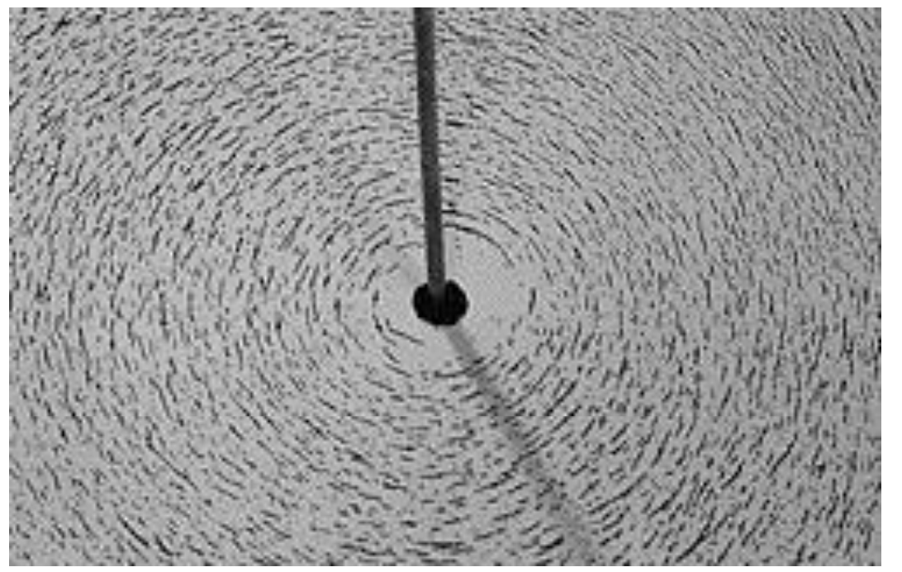
Why the iron filings arranged in circles?
The iron filings show the magnetic directions and show the field lines
They are like small magnetics and align along the direction of the field line.
https://www.youtube.com/watch?v=caHXwJbkbQU

Slide 31
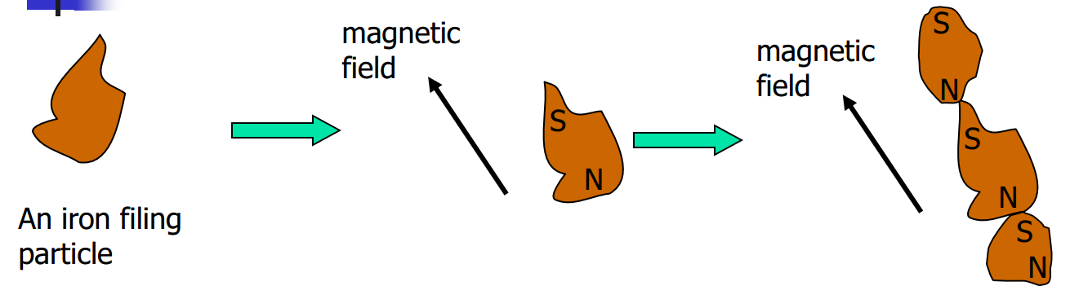
Alignment of iron filing particles by magnetic field
Magnetic field can change iron particles into small magnets
They are rotated so that the small magnets are aligned
The north poles are attracted to the south poles and they are aligned along the direction of the field and thus the field line

Slide 32
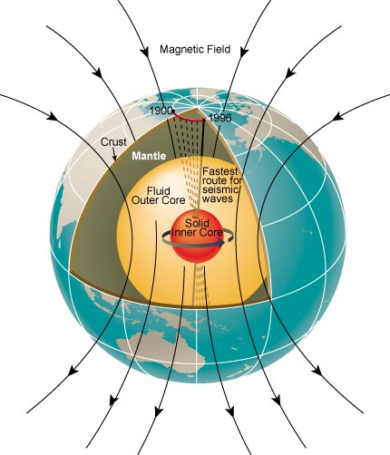
Magnetism of the earth
Earth’s magnetic field comes from two sources
Outer core of earth
Main field from the internal part (called outer core) of the earth amounts to 90% of the field
The outer core of earth consists of liquid metal, there is a flow of the liquid metal in the outer core
Motion of liquid metal generates a current, which produces the earth’s magnetic field
The inner core of earth is solid
Atmosphere
10% from motion of ions and electrons in the atmosphere

Slide 33
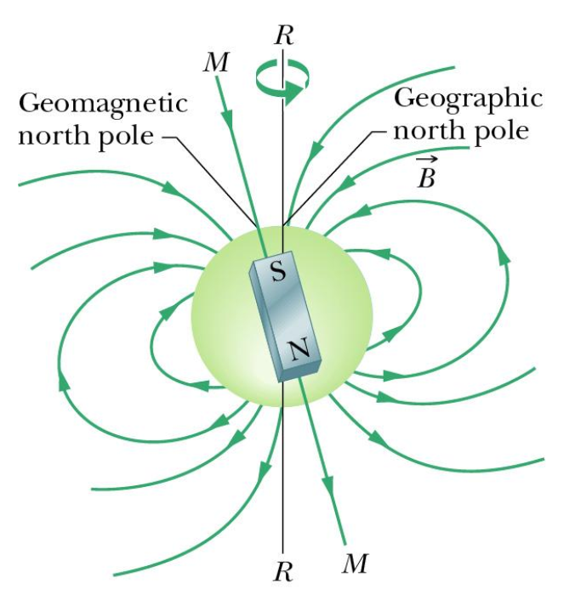
Earth’s magnetic field
Earth’s magnetic field can be modelled by an internal magnet. The axis MM makes an angle with Earth’s rotational axis RR. Note that the south pole of the internal magnet is in Earth’s northern hemisphere.

Slide 34
Magnetic declination
The magnetic north pole is not exactly at the north pole
There is a magnetic declination, i.e., the direct a compass pointing to is not the real north of the earth
The Earth’s magnetic north pole is changing every day

Slide 35
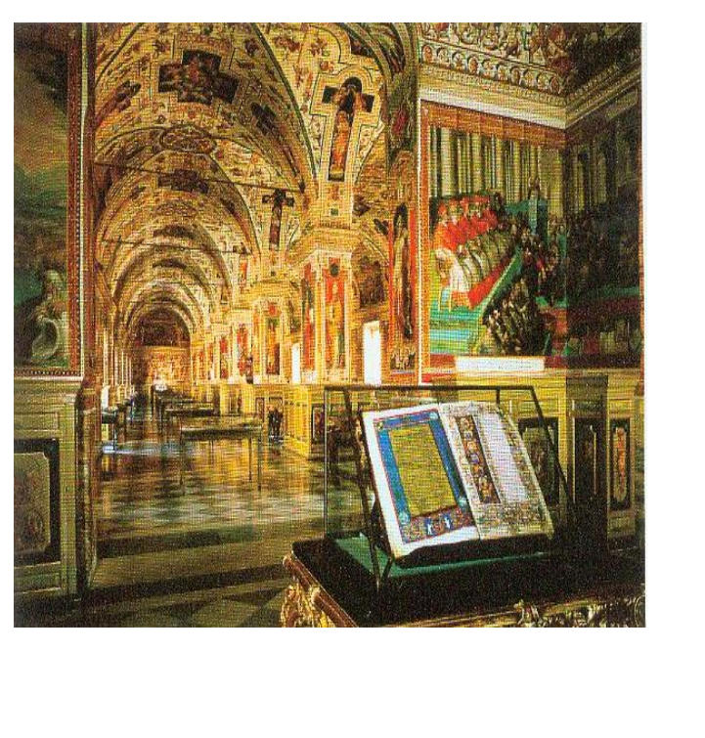
Direction of Earth’s magnetic field recorded by mural paintings
The red pigments used in many mural paintings contain grains of iron oxide hematite. When a pigment is applied to a wall as a mural is being created, each grain of hematite rotates in the liquid paint to align with the Earth’s magnetic field. When the paint dries, the moments are locked into place and thus record the direction of the Earth’s magnetic field at the time of painting.

Slide 36
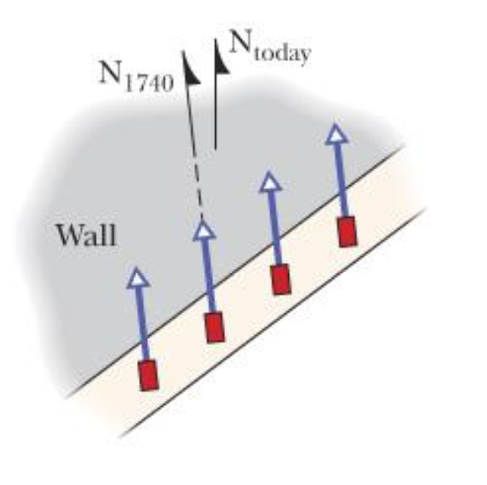
Change in the direction of the Earth’s magnetic field since 1740
Overhead view of a cross section of a thin layer of paint in a Vatican mural paint. The magnetic moments of hematite grains in the red pigments are aligned in the direction of Earth’s magnetic field had when the mural was painted in 1740. Geomagnetic north is shown for today and for 1740.

Slide 37
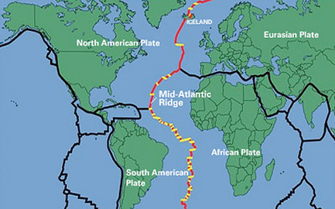
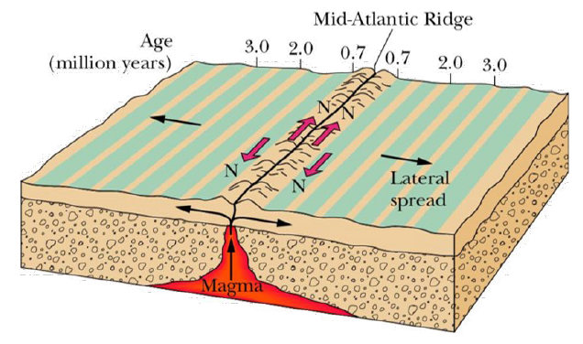
Reversal of polarity of Earth’s magnetic field
A magnetic profile of the seafloor on either side of the Mid-Atlantic Ridge. The seafloor, extruded through the ridge and spreading out as part of the tectonic drift system, displays a record of the past magnetic history of Earth’s core. The direction of the magnetic field produced by the core reverses about every million years.

Slide 38
Magnetic induction
A magnet moves towards a coil, current is created in the coil
The direction of current produce a magnetic field opposite to the motion of the magnet
This is the result of the change in magnetic flux in the coil
The flux in the coil = cross-section area of the coil x magnetic field (component that perpendicular to the coil)
The field is increased by magnet moves closer, this increase the flux

Slide 39
Another way to change of magnetic flux
Magnetic flux = magnetic field x area
Change of magnetic flux can produce electric potential difference and then current
Move the rod to increase the area and increase the flux
➔Convert kinetic energy to electric energy

Slide 40
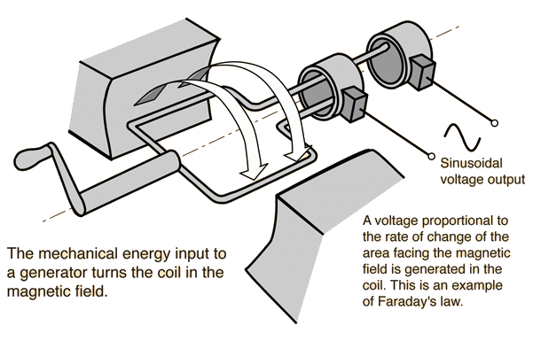
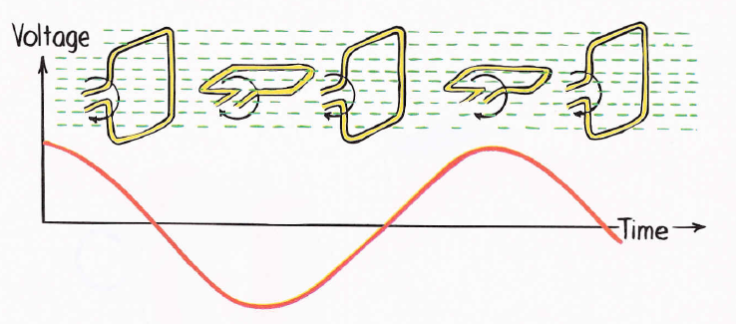

Application in electricity generation
Rotation of the loop in the generator changes the flux
Flux = perpendicular component of the magnetic field x the area
Rotation changes the perpendicular component and thus change the flux
This is use to generate electric current from rotation motion
$$Flux=BA\cos{θ}$$

Slide 41
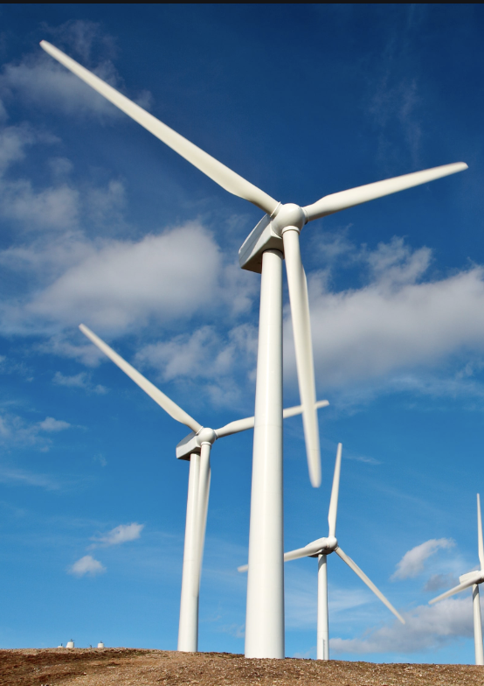
Power generation
Coal is burnt to boil water to create steam, steam makes the turbine to rotate
this rotates the generator and thus generate electric current
Wind makes the blade to rotate and rotate the generator

